Slide 1
ELEMENTARY STATISTICS, BLUMAN
BoxPlots – Focus on Distributions
© 2019 McGraw-Hill Education. All rights reserved. Authorized only for instructor use in the classroom. No reproduction or further distribution permitted without the prior written consent of McGraw-Hill Education.

Slide 2
Objectives for this PowerPoint
Define the Five Number Summary
Construct a Boxplot

Slide 3
Example 1 (1)
21 | 53
21 | 53
24 | 54
24 | 57
32 | 58
34 | 59
35 | 60
36 | 61
38 | 64
42 | 64
44 | 65
45 | 84
46 | 89
47 | 92
51 | 98
Thirty students in a class took a test. The scores are shown to the right. The instructor wished to find the quartiles for this set of data. The quartiles separate a data set into 4 equal groups.
In a previous PowerPoint we learned how to find the quartiles for a set of data.
Q₁ = 36
Q₂ = Median = 52
Q₃ = 61

Slide 4
Example 1 (2)
By including the minimum and maximum values for the data set, we define what is known as the Five Number Summary.
Five Number Summary
Min = 21
Q₁ = 36
Q₂ = Median = 52
Q₃ = 61
Max = 98

Slide 5
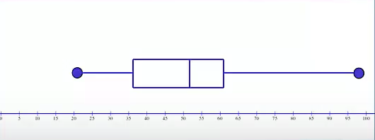
Example 1 (3)
Using the Five Number Summary we can construct a graphical display of the data called a Boxplot.
We begin drawing a boxplot by first constructing a scale. The scale should extend from below the minimum value to above the maximum value.
Min = 21 Max = 98

Slide 6
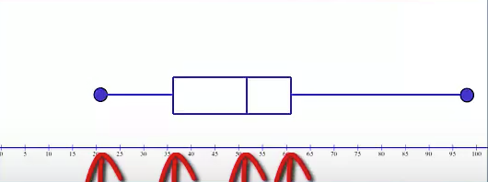
Example 1 (4)
Locate minimum value, 1st quartile, median, 3rd quartile, and maximum value.
Min = 21
Q₁ = 36
Q₂ = Median = 52
Q₃ = 61
Max = 98

Slide 7
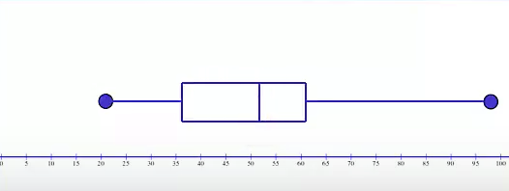
Example 1 (5)
Then draw a box whose vertical sides go through the 1st quartile median, and the 3rd quartile.
Draw a line from the minimum data value to the left side of the box and draw a line from the maximum value to the right side of the box.

Slide 8
Skewness of Data Set (1)
In some instances a boxplot can tell us about the skewness of a data set.
If the median is near the center of the box the distribution is approximately symmetric.
If the median falls to the left of the center of the box the distribution is positively skewed.
If the median falls to the right of the center the distribution is negatively skewed.

Slide 9
Skewness of Data Set (2)
If the lines are about the same length the distribution is approximately symmetric.
If the right line is larger than the left line the distribution is positively skewed.
If the left line is larger than the right line the distribution is negatively skewed.

Slide 10
Example 2 (1)
38 | 83
42 | 84
46 | 84
52 | 85
58 | 85
65 | 89
68 | 90
72 | 90
75 | 92
76 | 93
77 | 93
78 | 94
81 | 96
82 | 97
83 | 98
The instructor decided to allow the students to retake the test. The scores for the retake are shown below. The instructor wishes to find the Five Number Summary for the scores for the retaken test and draw a boxplot.
Min = 38
Q₁ = 72
Q₂ = Median = 83
Q₃ = 90
Max = 98

Slide 11
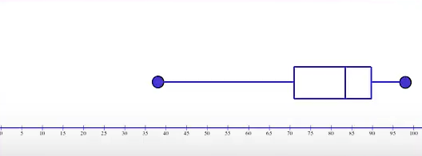
Example 2 (2)
Look at the boxplot for the 2nd set of data.
The median falls to the right of the center of the box. Therefore we might assume that the distribution is negatively skewed.
The left line is larger than the right line. Also indicating that the distribution may be negatively skewed.

Slide 12
Summary
In this PowerPoint we defined the Five Number Summary and learned how to construct a Boxplot.

